Slide 1



Department of Computer Science and Engineering, BRAC University
Lecture 8
Flip-Flops & Timing Diagrams
CSE260 : Digital Logic Design

Slide 2
Introduction
Two classes of logic circuits:
combinational
sequential
Combinational Circuit:
inputs
: :
Combinational
Logic
: :
outputs
‹#›
Department of Computer Science and Engineering
CSE260 - Digital Logic Design

Slide 3
Combinational Circuit vs. Sequential Circuit
Combinational
A combinational circuit consists of logic gates whose outputs at any time are determined directly from the present combination of inputs without regard to previous inputs.
A combinational circuit performs a specific information-processing operation fully specified logically by a set of Boolean functions.
Sequential
Sequential circuits employ memory elements in addition to logic gates. Their outputs are a function of the inputs and the state of memory elements
The state of memory elements, in turn, is a function of previous inputs. As a consequence, the outputs of a sequential circuit depend not only on present inputs, but also on past inputs.
‹#›
Department of Computer Science and Engineering
CSE260 - Digital Logic Design

Slide 4
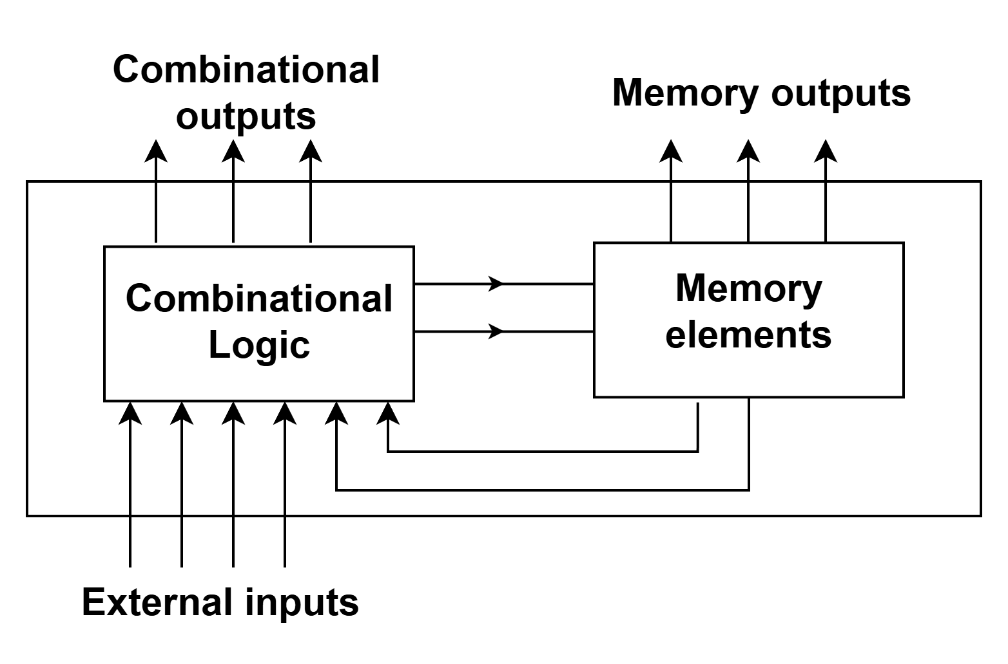
Sequential Circuit
A sequential circuit consists of a feedback path, and employs some memory elements.
Sequential circuit = Combinational logic + Memory Elements
output= external input + present state of memory element
‹#›
Department of Computer Science and Engineering
CSE260 - Digital Logic Design

Slide 5
Introduction
There are two types of sequential circuits:
synchronous: outputs change only at specific time (i.e. with clock input)
asynchronous: outputs change at any time (i.e. without clock input)
Multivibrator: a class of sequential circuits. They can be:
bistable (2 stable states)
monostable or one-shot (1 stable state)
astable (no stable state)
Bistable logic devices: flip-flops.
Flip-flops differ in the method used for changing their state.
‹#›
Department of Computer Science and Engineering
CSE260 - Digital Logic Design

Slide 6
Memory Elements
Memory element: a device which can remember value indefinitely, or change value on command from its inputs.
command
Memory element
Q
stored value
Q(t) : current state
Q(t+1) or Q⁺ : next state
‹#›
Department of Computer Science and Engineering
CSE260 - Digital Logic Design

Slide 7
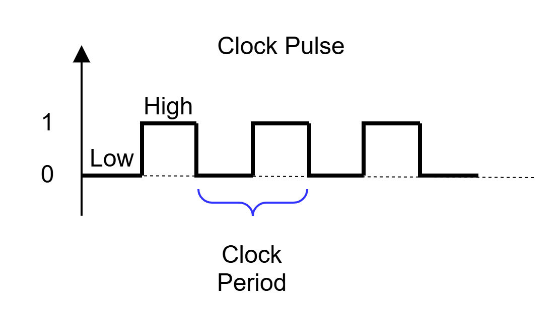
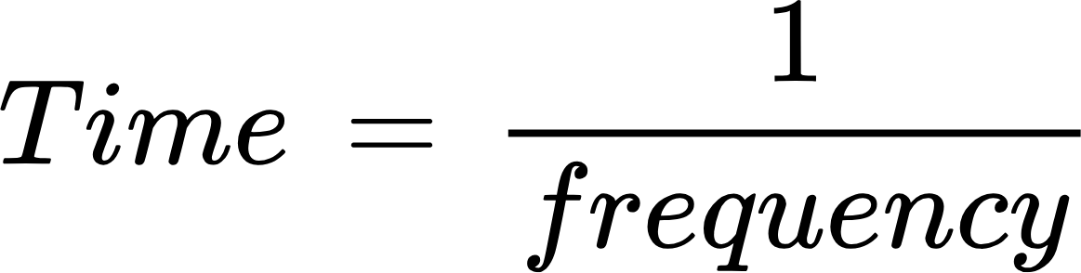
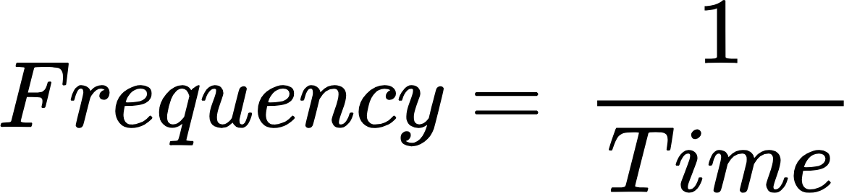
Clock Pulse
A clock pulse is a periodic signal (HIGH/LOW) that synchronizes state changes in sequential digital circuits
Controls timing in flip-flops, counters, registers
Properties:
Clock Period : The time taken to complete one cycle of a clock signal
(measured in seconds (s) or milliseconds (ms)).
Clock Frequency : The number of cycles per second (measured in Hertz (Hz)).
‹#›
Department of Computer Science and Engineering
CSE260 - Digital Logic Design

Slide 8
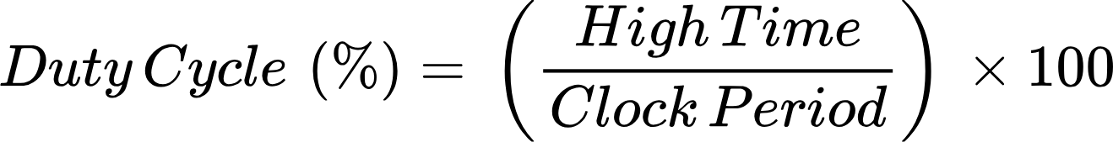
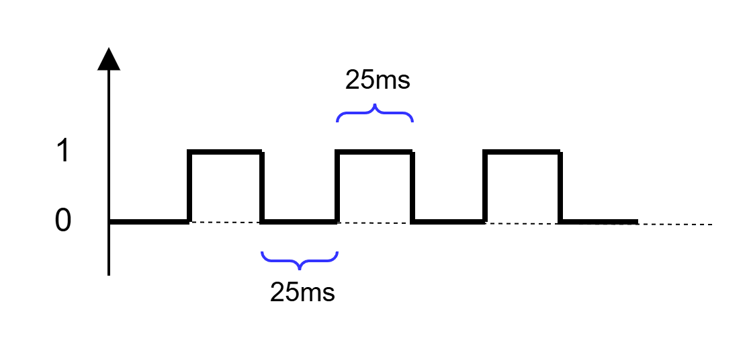
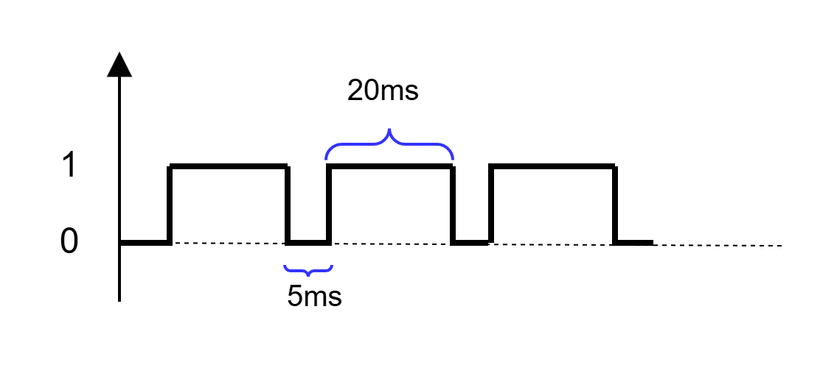


Clock Pulse
Duty Cycle :
The percentage of time the clock signal stays at a high (1) level within one cycle.
‹#›
Department of Computer Science and Engineering
CSE260 - Digital Logic Design

Slide 9
Triggering Mechanisms
Triggering refers to how and when a latch or flip-flop changes state based on the clock signal.
It determines when the stored value updates in a sequential circuit.
Level Triggering
Edge Triggering
Circuit reacts only at the transition point of the clock pulse.
Positive Edge (↑): Triggers when clock transitions from LOW to HIGH (0 → 1).
Negative Edge (↓): Triggers when clock transitions from HIGH to LOW (1 → 0).
Used in Flip flops, Registers
The circuit gives output during the entire duration when the clock is HIGH.
Positive Level: Active During High
Negative Level: Active During Low
Mostly Used in latches
‹#›
Department of Computer Science and Engineering
CSE260 - Digital Logic Design

Slide 10
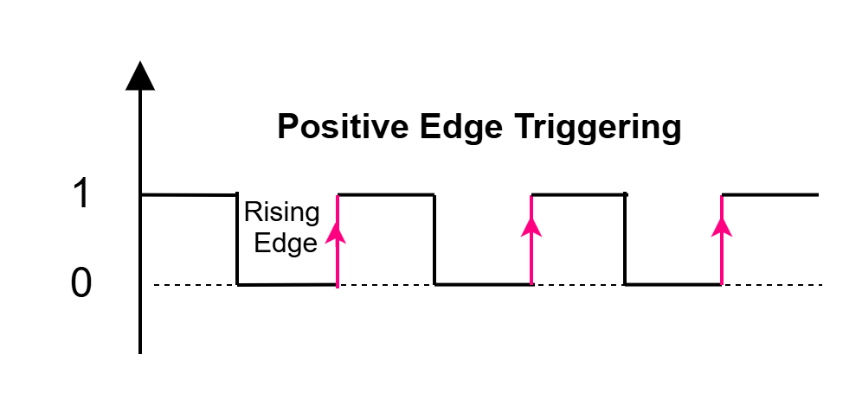
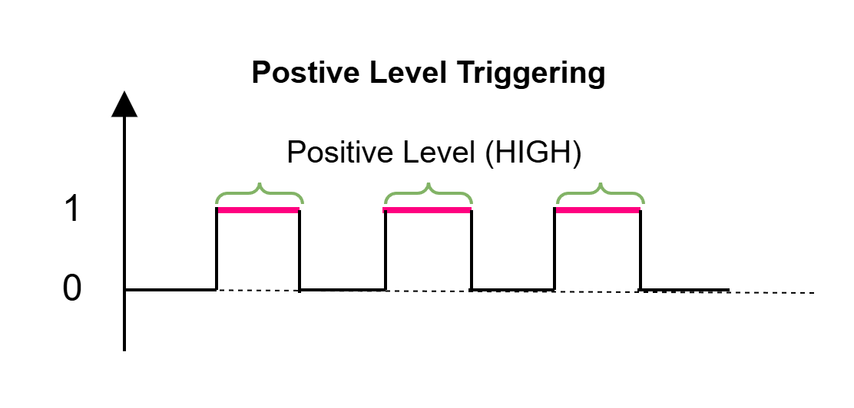
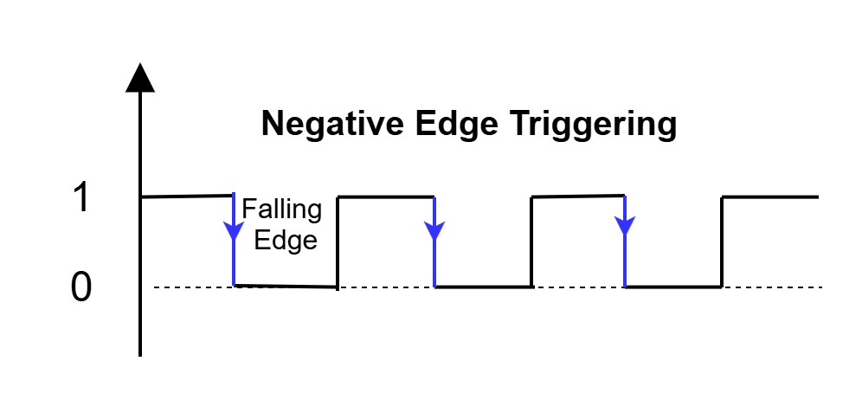
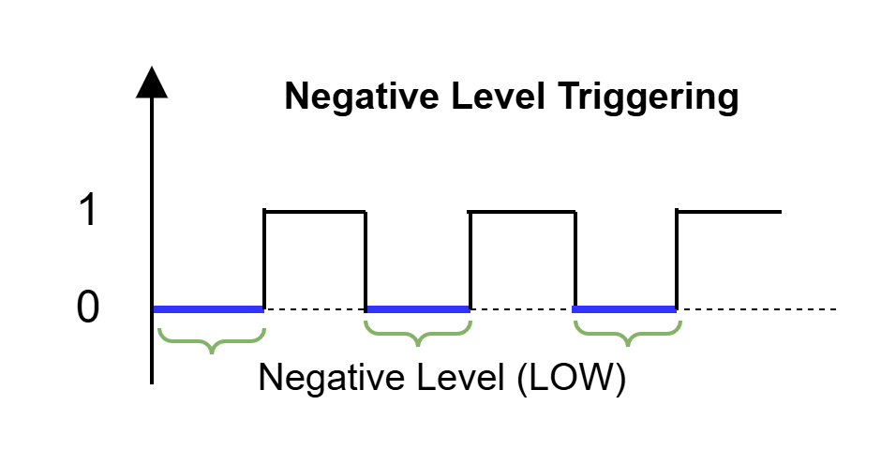
Triggering Mechanisms
Flip Flop’s State Changes
Latch’s State Changes
‹#›
Department of Computer Science and Engineering
CSE260 - Digital Logic Design

Slide 11
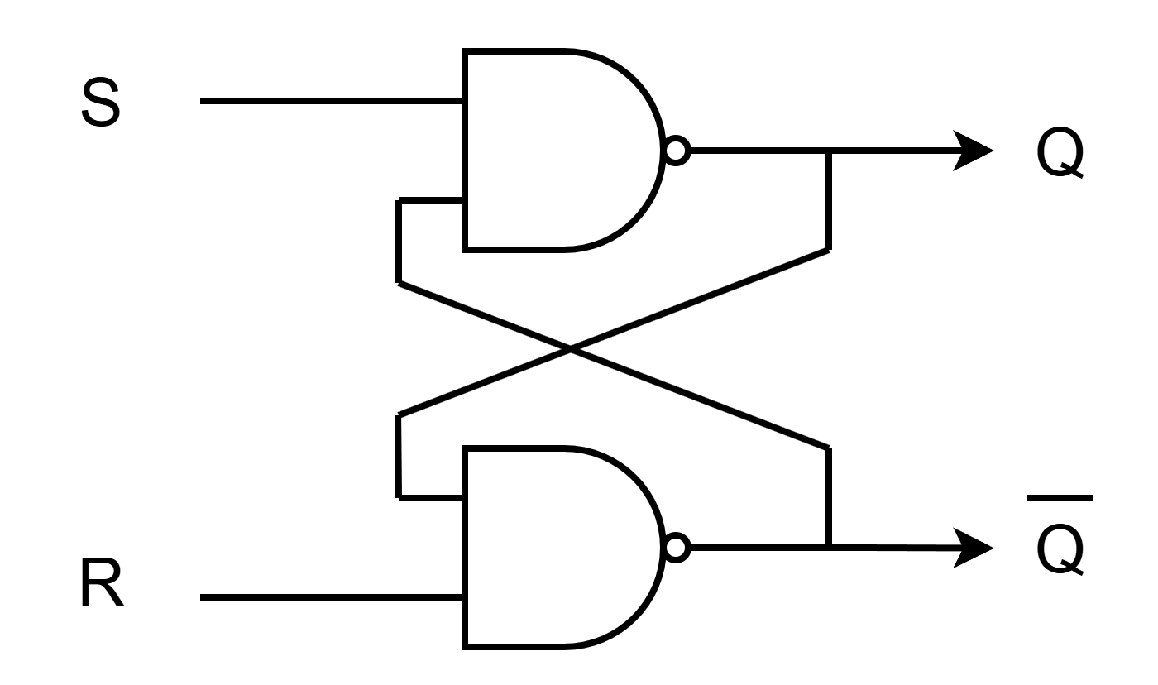
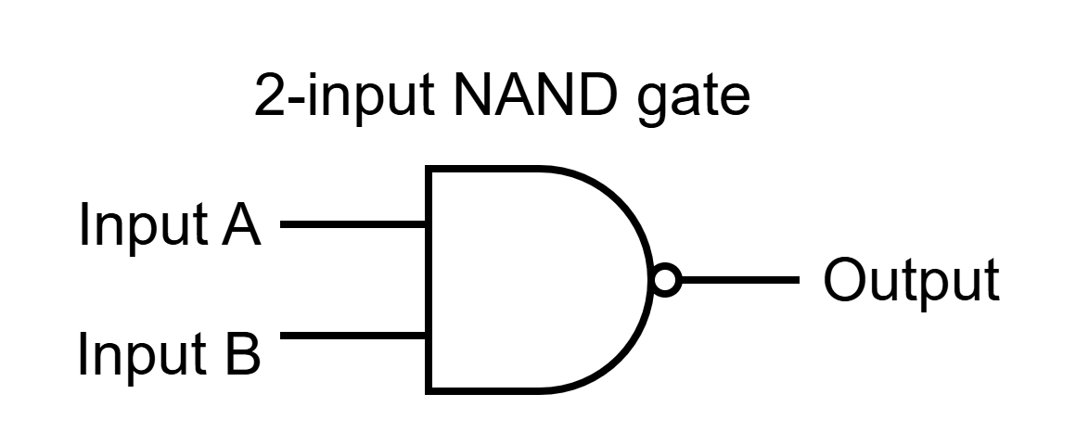
SR Latch Using NAND Gate
A | B | Output
0 | 0 | 1
0 | 1 | 1
1 | 0 | 1
1 | 1 | 0
We will need the knowledge of this truth table later
‹#›
Department of Computer Science and Engineering
CSE260 - Digital Logic Design

Slide 12
SR Latch Using NAND Gate
SR Latch Truth Table
CASE | S | R | Q | Q’ | Notes
1 | 0 | 1 | 1 | 0 | Calculation of Q done first
 | 1 | 1 | 1 | 0 | Q and Q’ remains unchanged
2 | 1 | 0 | 0 | 1 | Calculation of Q’ done first
 | 1 | 1 | 0 | 1 | Q and Q’ remains unchanged
3 | 0 | 0 | 1 | 1 | Impossible!
S | R | Q | Q’
0 | 0 | Not Used
0 | 1 | 1 | 0
1 | 0 | 0 | 1
1 | 1 | Memory/ No Change
‹#›
Department of Computer Science and Engineering
CSE260 - Digital Logic Design

Slide 13
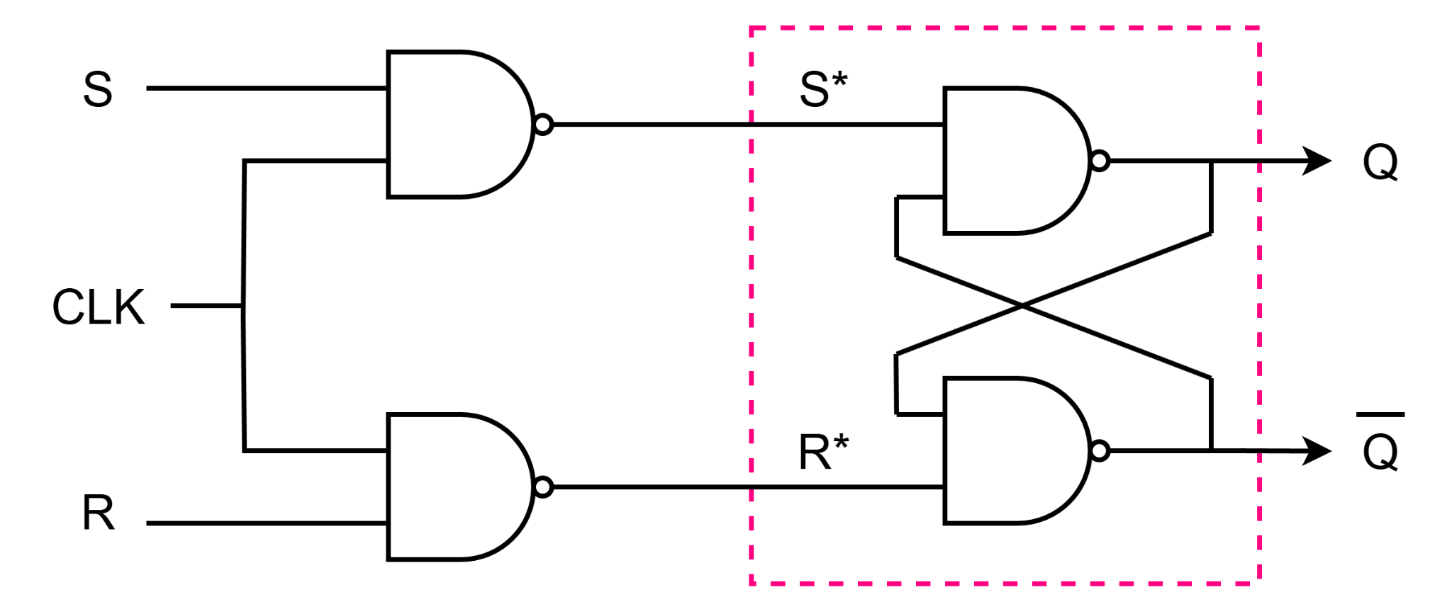
SR Flip Flop
Now we will use the knowledge of SR latch to build the truth table for SR FF. But before that, we need to do some calculation.
‹#›
Department of Computer Science and Engineering
CSE260 - Digital Logic Design

Slide 14
SR Flip Flop
If,
S=0, R=0, then S*=1, R*=1
S=0, R=1, then S*=1, R*=0
S=1, R=0, then S*=0, R*=1
S=1, R=1, then S*=0, R*=0
Let’s build the truth table now [this table also includes latch inputs, which are S* and R*.
S* = (S.CLK)’ = S’+ CLK’
R* = (R.CLK)’ = R’+ CLK’
Now, for a FF to work,
CLK must be 1. If CLK=1, then,
S* = S’+0 = S’
R* = R’+0 = R’
SR FF Final Truth Table
S | R | S* | R* | Q | Q’
0 | 0 | 1 | 1 | Memory/ No Change
0 | 1 | 1 | 0 | 0 | 1
1 | 0 | 0 | 1 | 1 | 0
1 | 1 | 0 | 0 | Not Used
S | R | Q | Q’
0 | 0 | Memory/ No Change
0 | 1 | 0 | 1
1 | 0 | 1 | 0
1 | 1 | Not Used
‹#›
Department of Computer Science and Engineering
CSE260 - Digital Logic Design

Slide 15
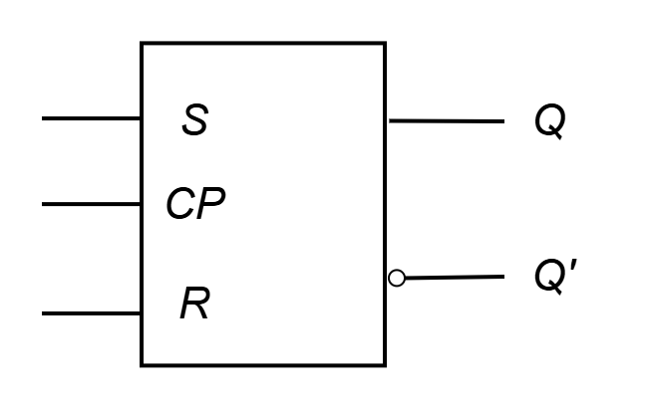
Clocked S-R FF Diagram
S-R FF + Clock Pulse (CP) and 2 NAND gates → Clocked S-R FF.
Circuit Diagram
Truth Table
CLK | S | R | Q | Q’
0 | X | X | X
1 | 0 | 0 | Memory/ No Change
1 | 0 | 1 | 0 | 1
1 | 1 | 0 | 1 | 0
1 | 1 | 1 | Not Used
Block Diagram
‹#›
Department of Computer Science and Engineering
CSE260 - Digital Logic Design

Slide 16
Types of tables in sequential circuit
Truth/Criteria Table
Lists all possible input combinations and corresponding outputs. [FF input = FF output]
Characteristic Table
Shows the flip-flop’s next state for given inputs and current state. [Present State + FF input = Next State]
Excitation Table
Shows the required inputs to flip-flops to cause a desired state transition. [Present State + Next State = FF input]
‹#›
Department of Computer Science and Engineering
CSE260 - Digital Logic Design

Slide 17
S-R Flip-Flop Truth + Characteristics Table
S | R | Q | Q’
0 | 0 | Memory/ No Change
0 | 1 | 0 | 1
1 | 0 | 1 | 0
1 | 1 | Not Used
While building the Characteristics table, always consider Q from the truth table as Q’ is just the complement of Q.
Characteristic Table
Q(t) | S | R | Q(t+1)
0 | 0 | 0 | 0
0 | 0 | 1 | 0
0 | 1 | 0 | 1
0 | 1 | 1 | indeterminate
1 | 0 | 0 | 1
1 | 0 | 1 | 0
1 | 1 | 0 | 1
1 | 1 | 1 | indeterminate
You always need to remember the truth table to build the characteristics table. Meaning, truth table comes first, characteristics table comes second. You can’t build characteristics table before truth table
‹#›
Department of Computer Science and Engineering
CSE260 - Digital Logic Design

Slide 18
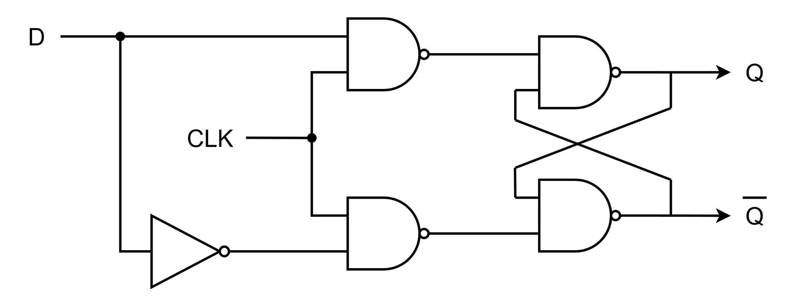
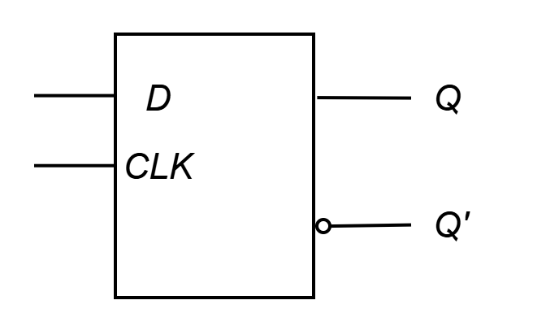
Clocked D- Flip Flop
Make R input equal to S' → D FF
D FF eliminates the undesirable condition of invalid state in the S-R FF.
‹#›
Department of Computer Science and Engineering
CSE260 - Digital Logic Design

Slide 19
D - FF Truth Table + Characteristic Table
D - FF Truth Table
D - FF Characteristic Table
D | Q | Q’
0 | 0 | 1
1 | 1 | 0
Q(t) | D | Q(t+1)
0 | 0 | 0
0 | 1 | 1
1 | 0 | 0
1 | 1 | 1
‹#›
Department of Computer Science and Engineering
CSE260 - Digital Logic Design

Slide 20
J-K Flip Flop
J-K flip-flop: Q and Q' are fed back to the NAND gates.
No invalid state.
Include a toggle state.
J=HIGH (and K=LOW) 🢧 SET state [Q = 1]
K=HIGH (and J=LOW) 🢧 RESET state [Q = 0]
both inputs LOW 🢧 no change [Memory]
both inputs HIGH 🢧 toggle [Q = Q’]
‹#›
Department of Computer Science and Engineering
CSE260 - Digital Logic Design

Slide 21
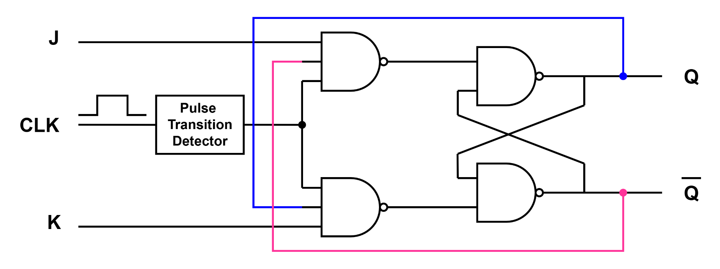
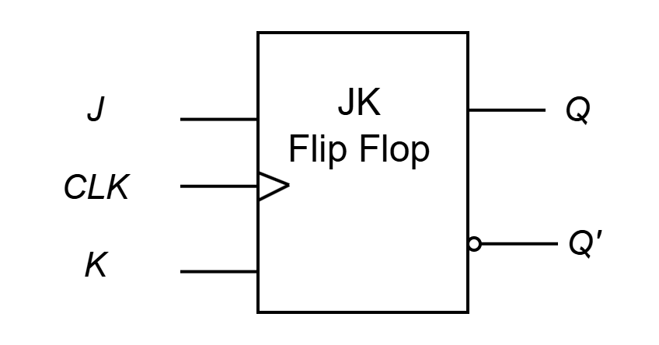
J-K Flip Flop
Characteristic Table
J | K | Q | Q’
0 | 0 | Memory/ No Change
0 | 1 | 0 | 1
1 | 0 | 1 | 0
1 | 1 | Toggle
Q(t) | J | K | Q(t+1)
0 | 0 | 0 | 0
0 | 0 | 1 | 0
0 | 1 | 0 | 1
0 | 1 | 1 | 1
1 | 0 | 0 | 1
1 | 0 | 1 | 0
1 | 1 | 0 | 1
1 | 1 | 1 | 0
JK
Flip Flop
Truth Table
‹#›
Department of Computer Science and Engineering
CSE260 - Digital Logic Design

Slide 22
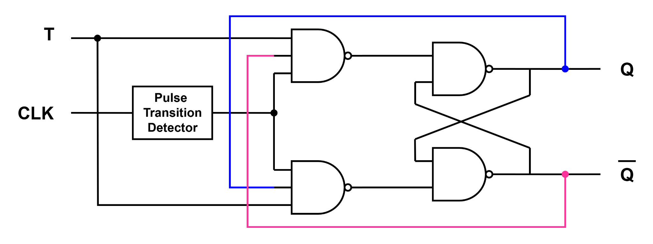
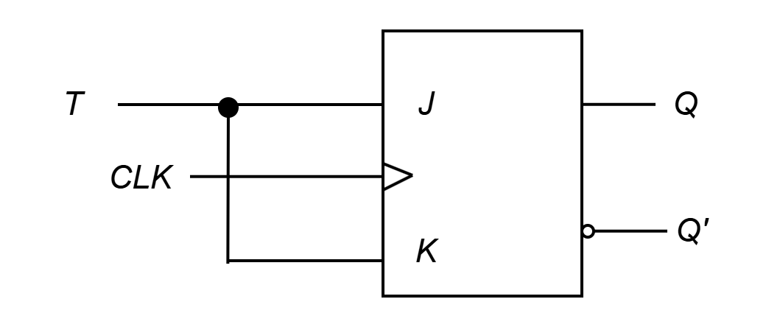
T Flip Flop
T flip-flop : single-input version of the J-K flip-flop, formed by tying both inputs together.
T - FF Truth Table
Characteristic Table
Q(t) | T | Q(t+1)
0 | 0 | 0
0 | 1 | 1
1 | 0 | 1
1 | 1 | 0
T | Q | Q’
0 | No change
1 | Toggle
‹#›
Department of Computer Science and Engineering
CSE260 - Digital Logic Design

Slide 23
Try it Yourself (Self Study)
(Learn it yourself) (Draw both circuit and block diagram)
Design a D FF using SR FF
Design a T FF using JK FF
Design a D FF using JK FF
‹#›
Department of Computer Science and Engineering
CSE260 - Digital Logic Design

Slide 24
Flip Flop Excitation Tables
Excitation Tables : Given the required transition from present state to next state, determine the flip-flop input(s)
JK Flip-Flop
SR Flip-Flop
Q | Q⁺ | J | K
0 | 0 | 0 | X
0 | 1 | 1 | X
1 | 0 | X | 1
1 | 1 | X | 0
Q | Q⁺ | S | R
0 | 0 | 0 | x
0 | 1 | 1 | 0
1 | 0 | 0 | 1
1 | 1 | X | 0
T Flip-Flop
D Flip-Flop
Q | Q⁺ | T
0 | 0 | 0
0 | 1 | 1
1 | 0 | 1
1 | 1 | 0
Q | Q⁺ | D
0 | 0 | 0
0 | 1 | 1
1 | 0 | 0
1 | 1 | 1
‹#›
Department of Computer Science and Engineering
CSE260 - Digital Logic Design

Slide 25

Analyzing Flip-Flop Behavior with Timing Diagrams
4 types based on the triggering mechanism of the Flip Flop
Positive Level Triggered
Negative Level Triggered
Positive/ Rising Edge Triggered
Negative/ Falling Edge Triggered
Latch
Flip Flop
‹#›
Department of Computer Science and Engineering
CSE260 - Digital Logic Design

Slide 26
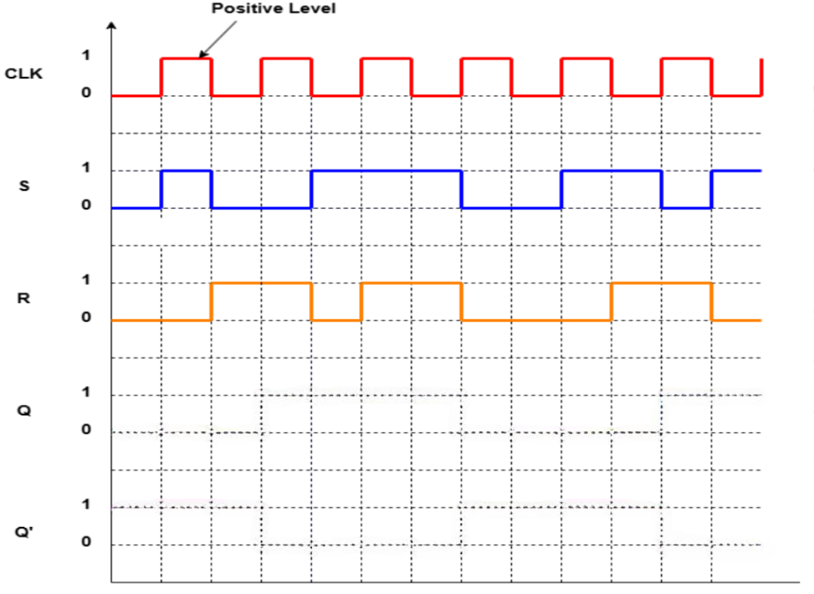
Positive Level Triggered Timing Diagram
CLK, S, R signal will be given in question
Positive - 1
Negative - 0
Positive level found
SR Latch Truth Table
1
S | R | Q | Q'
0 | 0 | Not Used
0 | 1 | 1 | 0
1 | 0 | 0 | 1
1 | 1 | Memory/No Change
0
Keep the signal to 0 as Q=0
Truth table will not be given in the question
‹#›
Department of Computer Science and Engineering
CSE260 - Digital Logic Design

Slide 27
Positive Level Triggered Timing Diagram
Negative level found
SR Latch Truth Table
1
S | R | Q | Q'
0 | 0 | Not Used
0 | 1 | 1 | 0
1 | 0 | 0 | 1
1 | 1 | Memory/No Change
0
No need to check input signal values [S and R] Keep the signal to 0 as the previous step
‹#›
Department of Computer Science and Engineering
CSE260 - Digital Logic Design

Slide 28
Positive Level Triggered Timing Diagram
Positive level found
SR Latch Truth Table
1
0
S | R | Q | Q'
0 | 0 | Not Used
0 | 1 | 1 | 0
1 | 0 | 0 | 1
1 | 1 | Memory/No Change
0
1
Move the signal to 1 as Q=1
‹#›
Department of Computer Science and Engineering
CSE260 - Digital Logic Design

Slide 29
Positive Level Triggered Timing Diagram
Negative level found
SR Latch Truth Table
S | R | Q | Q'
0 | 0 | Not Used
0 | 1 | 1 | 0
1 | 0 | 0 | 1
1 | 1 | Memory/No Change
No need to check input signal values [S and R] Keep the signal to 1 as the previous step
‹#›
Department of Computer Science and Engineering
CSE260 - Digital Logic Design

Slide 30
Positive Level Triggered Timing Diagram
SR Latch Truth Table
S | R | Q | Q'
0 | 0 | Not Used
0 | 1 | 1 | 0
1 | 0 | 0 | 1
1 | 1 | Memory/No Change
Continue like this…
‹#›
Department of Computer Science and Engineering
CSE260 - Digital Logic Design

Slide 31
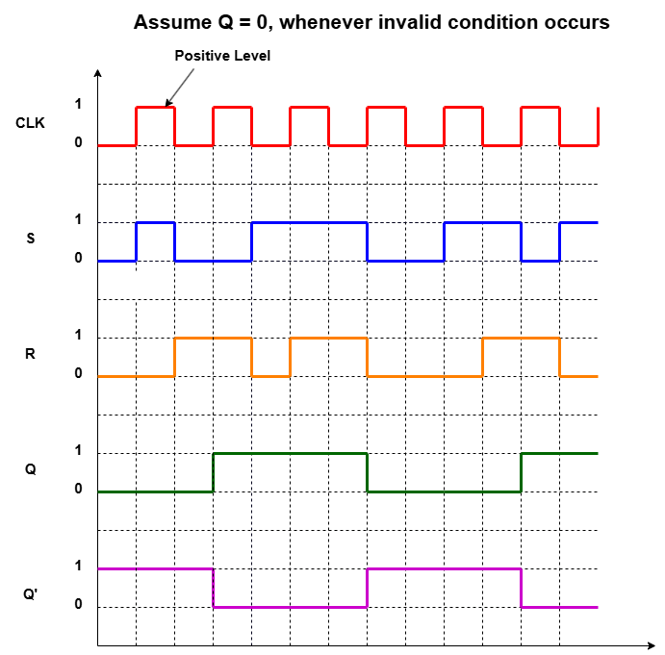
Positive Level Triggered Timing Diagram
SR Latch Truth Table
S | R | Q | Q'
0 | 0 | Not Used
0 | 1 | 1 | 0
1 | 0 | 0 | 1
1 | 1 | Memory/No Change
‹#›
Department of Computer Science and Engineering
CSE260 - Digital Logic Design

Slide 32
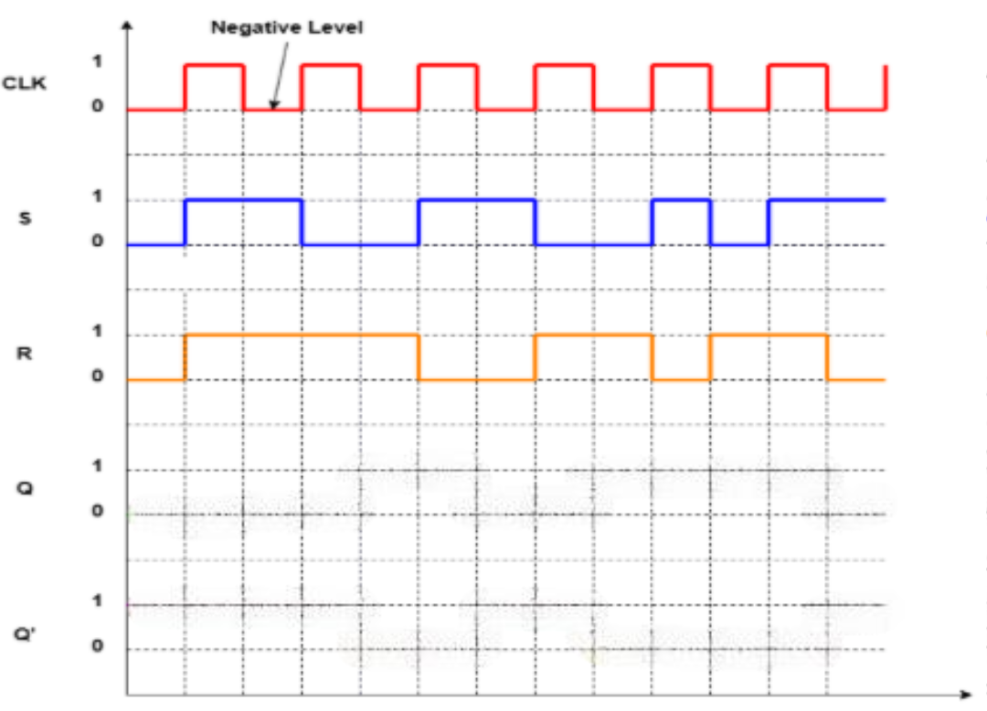
Negative Level Triggered Timing Diagram
Positive level found
SR Latch Truth Table
S | R | Q | Q'
0 | 0 | Not Used
0 | 1 | 1 | 0
1 | 0 | 0 | 1
1 | 1 | Memory/No Change
No need to check input signal values [S and R] Keep the signal to 0 as the previous step
‹#›
Department of Computer Science and Engineering
CSE260 - Digital Logic Design

Slide 33
Negative Level Triggered Timing Diagram
Negative level found
SR Latch Truth Table
1
S | R | Q | Q'
0 | 0 | Not Used
0 | 1 | 1 | 0
1 | 0 | 0 | 1
1 | 1 | Memory/No Change
1
Keep the signal to 0 as Q=No Change
‹#›
Department of Computer Science and Engineering
CSE260 - Digital Logic Design

Slide 34
Negative Level Triggered Timing Diagram
Positive level found
SR Latch Truth Table
S | R | Q | Q'
0 | 0 | Not Used
0 | 1 | 1 | 0
1 | 0 | 0 | 1
1 | 1 | Memory/No Change
No need to check input signal values [S and R] Keep the signal to 0 as the previous step
‹#›
Department of Computer Science and Engineering
CSE260 - Digital Logic Design

Slide 35
Negative Level Triggered Timing Diagram
Negative level found
SR Latch Truth Table
0
S | R | Q | Q'
0 | 0 | Not Used
0 | 1 | 1 | 0
1 | 0 | 0 | 1
1 | 1 | Memory/No Change
1
Move the signal to 1 as Q=1
‹#›
Department of Computer Science and Engineering
CSE260 - Digital Logic Design

Slide 36
Negative Level Triggered Timing Diagram
SR Latch Truth Table
S | R | Q | Q'
0 | 0 | Not Used
0 | 1 | 1 | 0
1 | 0 | 0 | 1
1 | 1 | Memory/No Change
Continue like this…
‹#›
Department of Computer Science and Engineering
CSE260 - Digital Logic Design

Slide 37
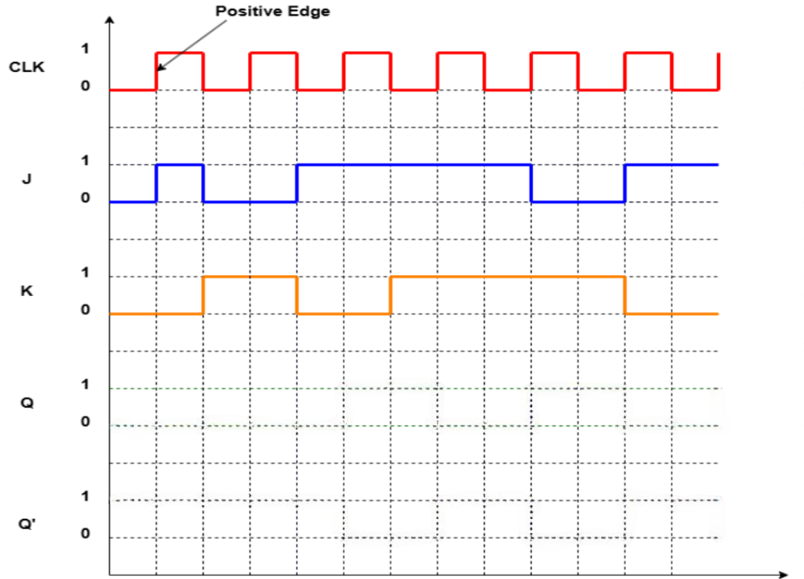
Positive Edge Triggered Timing Diagram
First positive edge found
Check the values from the immediate previous step of the positive edge
JK FF Truth Table
0
0
1
1
1
0
1
J | K | Q | Q’
0 | 0 | Memory/ No Change
0 | 1 | 0 | 1
1 | 0 | 1 | 0
1 | 1 | Toggle
0
1
0
1
1
1
0
J=0 and K=0,
Check truth table, Q=No Change for J=K=0.
Now, draw the signal
Keep the signal in 0 level for NO CHANGE.
Continue until next positive edge.
‹#›
Department of Computer Science and Engineering
CSE260 - Digital Logic Design

Slide 38
Positive Edge Triggered Timing Diagram
Next positive edge found
Check the values from the immediate previous step of the positive edge
JK FF Truth Table
0
0
1
1
1
0
1
J | K | Q | Q’
0 | 0 | Memory/ No Change
0 | 1 | 0 | 1
1 | 0 | 1 | 0
1 | 1 | Toggle
0
1
0
1
1
1
0
J=0 and K=1,
Check truth table, Q=0 for J=0 and K=1.
Now, draw the signal
Keep the signal in 0 level as Q=0
Continue until next positive edge.
‹#›
Department of Computer Science and Engineering
CSE260 - Digital Logic Design

Slide 39
Positive Edge Triggered Timing Diagram
Next positive edge found
Check the values from the immediate previous step of the positive edge
JK FF Truth Table
0
0
1
1
1
0
1
J | K | Q | Q’
0 | 0 | Memory/ No Change
0 | 1 | 0 | 1
1 | 0 | 1 | 0
1 | 1 | Toggle
0
1
0
1
1
1
0
J=1 and K=0,
Check truth table, Q=1 for J=1 and K=0.
Now, draw the signal
Move the signal to 1 as Q=1
Continue until next positive edge.
‹#›
Department of Computer Science and Engineering
CSE260 - Digital Logic Design

Slide 40
Positive Edge Triggered Timing Diagram
Next positive edge found
Check the values from the immediate previous step of the positive edge
JK FF Truth Table
0
0
1
1
1
0
1
J | K | Q | Q’
0 | 0 | Memory/ No Change
0 | 1 | 0 | 1
1 | 0 | 1 | 0
1 | 1 | Toggle
0
1
0
1
1
1
0
J=1 and K=1,
Check truth table, Q=Toggle for J=1 and K=1.
Now, draw the signal
Move the signal to 0 as Q=Toggle
Continue until next positive edge.
‹#›
Department of Computer Science and Engineering
CSE260 - Digital Logic Design

Slide 41
Positive Edge Triggered Timing Diagram
JK FF Truth Table
0
0
1
1
1
0
1
J | K | Q | Q’
0 | 0 | Memory/ No Change
0 | 1 | 0 | 1
1 | 0 | 1 | 0
1 | 1 | Toggle
0
1
0
1
1
1
0
Continue like this…..
‹#›
Department of Computer Science and Engineering
CSE260 - Digital Logic Design

Slide 42
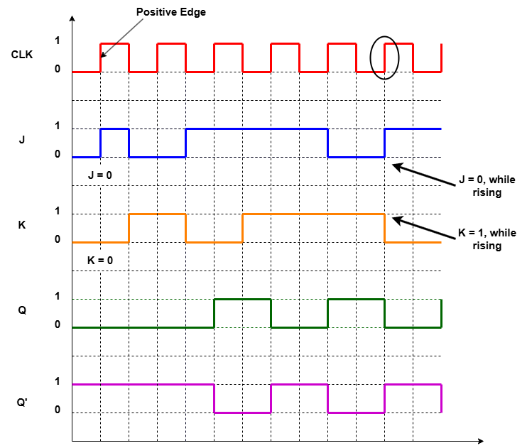
Positive Edge Triggered Timing Diagram
JK FF Truth Table
J | K | Q | Q’
0 | 0 | Memory/ No Change
0 | 1 | 0 | 1
1 | 0 | 1 | 0
1 | 1 | Toggle
‹#›
Department of Computer Science and Engineering
CSE260 - Digital Logic Design

Slide 43
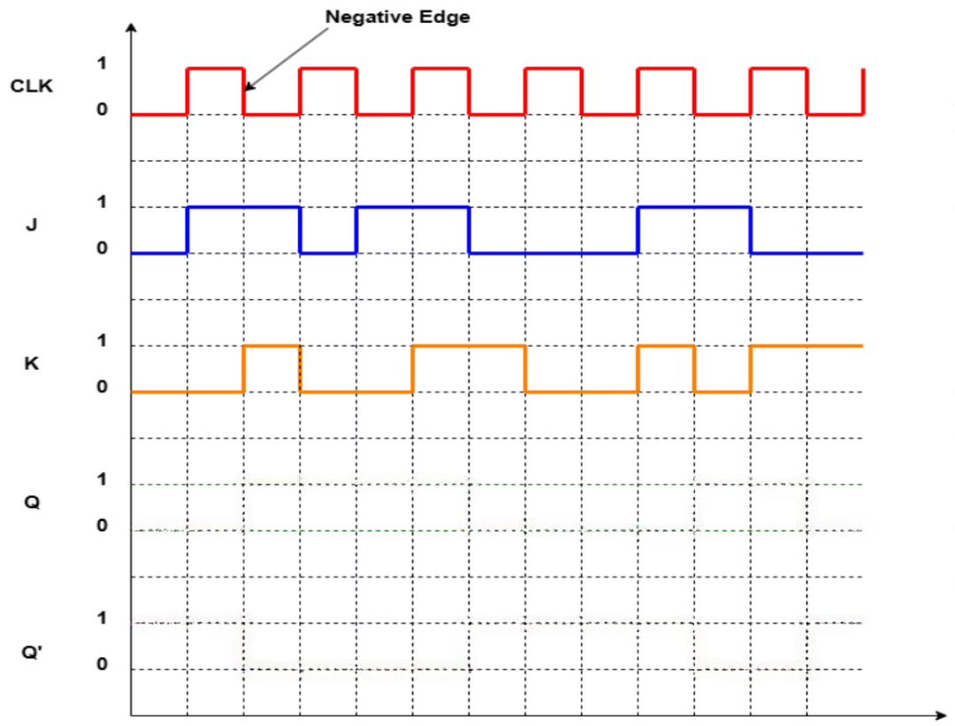
Negative Edge Triggered Timing Diagram
First negative edge found
Check the values from the immediate previous step of the negative edge
JK FF Truth Table
1
0
1
0
1
0
J | K | Q | Q’
0 | 0 | Memory/ No Change
0 | 1 | 0 | 1
1 | 0 | 1 | 0
1 | 1 | Toggle
0
0
1
0
1
1
J=1 and K=0,
Check truth table, Q=1 for J=1 and K=0.
Now, draw the signal
Move the signal to 1 as Q=1
Continue until next negative edge.
Haven’t reached the first negative edge, so keep the signal to Q=0 as the previous step
‹#›
Department of Computer Science and Engineering
CSE260 - Digital Logic Design

Slide 44
Negative Edge Triggered Timing Diagram
Next negative edge found
Check the values from the immediate previous step of the negative edge
JK FF Truth Table
1
0
1
0
1
0
J | K | Q | Q’
0 | 0 | Memory/ No Change
0 | 1 | 0 | 1
1 | 0 | 1 | 0
1 | 1 | Toggle
0
0
1
0
1
1
J=0 and K=0,
Check truth table, Q=No Change
Now, draw the signal
Keep the signal to 1 as Q= No change
Continue until next negative edge.
‹#›
Department of Computer Science and Engineering
CSE260 - Digital Logic Design

Slide 45
Negative Edge Triggered Timing Diagram
Next negative edge found
Check the values from the immediate previous step of the negative edge
JK FF Truth Table
1
0
1
0
1
0
J | K | Q | Q’
0 | 0 | Memory/ No Change
0 | 1 | 0 | 1
1 | 0 | 1 | 0
1 | 1 | Toggle
0
0
1
0
1
1
J=1 and K=1,
Check truth table, Q=Toggle
Now, draw the signal
Move the signal to 0 as Q = Toggle
Continue until next negative edge.
‹#›
Department of Computer Science and Engineering
CSE260 - Digital Logic Design

Slide 46
Negative Edge Triggered Timing Diagram
Next negative edge found
Check the values from the immediate previous step of the negative edge
JK FF Truth Table
1
0
1
0
1
0
J | K | Q | Q’
0 | 0 | Memory/ No Change
0 | 1 | 0 | 1
1 | 0 | 1 | 0
1 | 1 | Toggle
0
0
1
0
1
1
J=0 and K=0,
Check truth table, Q=No Change
Now, draw the signal
Keep the signal to 0 as Q = No change
Continue until next negative edge.
‹#›
Department of Computer Science and Engineering
CSE260 - Digital Logic Design

Slide 47
Negative Edge Triggered Timing Diagram
JK FF Truth Table
1
0
1
0
1
0
J | K | Q | Q’
0 | 0 | Memory/ No Change
0 | 1 | 0 | 1
1 | 0 | 1 | 0
1 | 1 | Toggle
0
0
1
0
1
1
Continue like this….
‹#›
Department of Computer Science and Engineering
CSE260 - Digital Logic Design

Slide 48
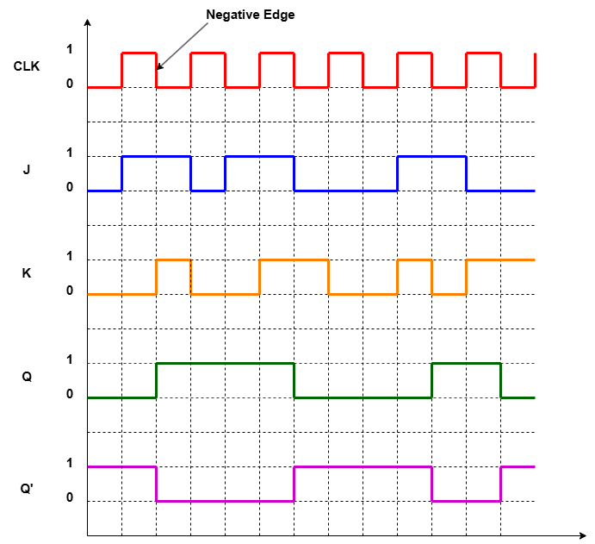
Negative Edge Triggered Timing Diagram
JK FF Truth Table
J | K | Q | Q’
0 | 0 | Memory/ No Change
0 | 1 | 0 | 1
1 | 0 | 1 | 0
1 | 1 | Toggle
‹#›
Department of Computer Science and Engineering
CSE260 - Digital Logic Design

Slide 49
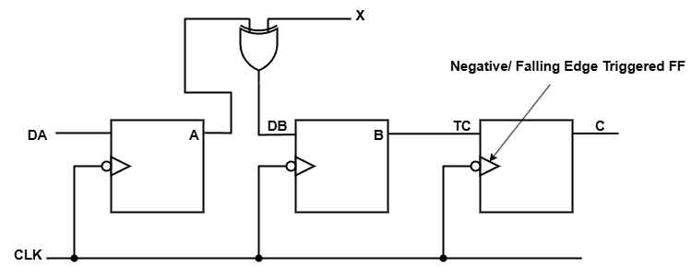
Example: Draw Timing Diagram for A, DB, B and C
‹#›
Department of Computer Science and Engineering
CSE260 - Digital Logic Design

Slide 50
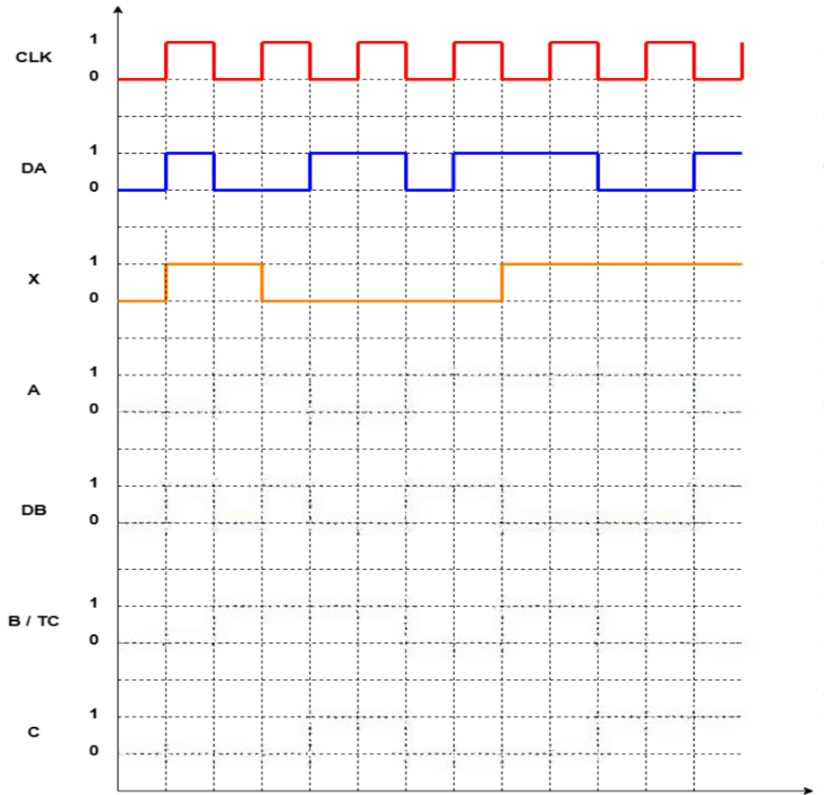
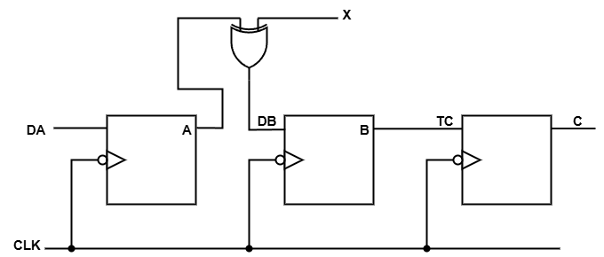
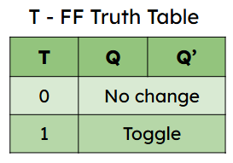
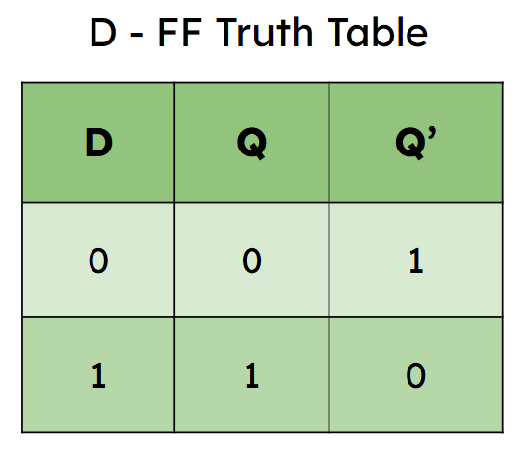
Solution (CLK, DA and X are Given)
1
0
1
1
1
0
1
0
0
0
1
1
Here,
Find out value of A based upon D FF’s truth table
DB = A xor X [use XOR gate truth table to find out values]
Find out value of C based upon T FF’s truth table
‹#›
Department of Computer Science and Engineering
CSE260 - Digital Logic Design

Slide 51
Solution (CLK, DA and X are Given)
1
0
1
1
1
0
1
0
0
0
1
1
Here,
Find out value of A based upon D FF’s truth table
DB = A xor X [use XOR gate truth table to find out values]
Find out value of C based upon T FF’s truth table
‹#›
Department of Computer Science and Engineering
CSE260 - Digital Logic Design

Slide 52
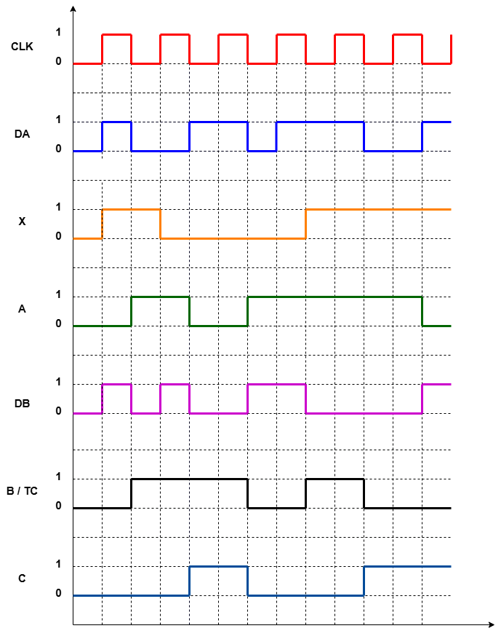
Solution (CLK, DA and X are Given)
Here,
Find out value of A based upon D FF’s truth table
DB = A xor X [use XOR gate truth table to find out values]
Find out value of C based upon T FF’s truth table
‹#›
Department of Computer Science and Engineering
CSE260 - Digital Logic Design

